Slide 1

PAC Technology Strategy
Engineering a smaller world

Slide 2
AGENDA
IT Vision and Mission
IT 2014/2015 Strategic Objectives
IT Culture
IT Organizational Structure
Insourcing & Outsourcing strategy
The Cloud
Microsoft Azure Data Center
Windows Azure Platform Building Blocks
Data center regions
Scalability
Service Level Agreements
Data center usage
Software Development Process
High Level Technology Overview and Products
High Level Business Process Flow
Roadmap

Slide 3
IT VISION
To deliver solid and fast solutions.
IT MISSION
Hire subject matter experts and keep them.
2014-2015 STRATEGIC OBJECTIVES
Hire core team
Build key software applications
Create client profiles
Implement PCRP
Algorithm
Create framework to handle Big Data
CULTURE
Results Orientation
Great Place to Work
Collaboration

Slide 4
IT Organizational Structure

Slide 5
Insourcing & Outsourcing Strategy
Outsource any commoditized components and insource all strategic components.
Outsource to the cloud:
Virtual machines, virtual networks, could services, relational databases, Hadoop clusters, storage, backup, site recovery, active directory, etc.
Insource:
Key software applications and algorithms in order to:
Have full control of company software secrets.
Deliver fast time to market solutions.
Ensure high software quality.
Adapt quickly to company and customer needs.

Slide 6

Business Benefits of the Cloud
Top five advantages of cloud computing:
Pay only for what you use
Easy/fast deployment to end users
Monthly payments
Encourages standard systems
Requires less in-house staff, costs

Slide 7
Defining the Cloud
Deployment Models
Service Models
Private Cloud
Public Cloud
Hybrid Cloud
Infrastructure as a Service
(IaaS)
Platform as a Service
PaaS
Software as a Service
SaaS

Slide 8
Cloud Computing Taxonomy
Packaged Software
Infrastructure
(as a Service)
Platform
(as a Service)
Software
(as a Service)
Applications
Applications
You manage
Applications
Applications
Data
You manage
Data
Data
Data
Runtime
Runtime
Runtime
Runtime
Managed by vendor
You manage
Middleware
Middleware
Middleware
Middleware
Managed by vendor
O/S
O/S
O/S
O/S
Virtualization
Virtualization
Managed by vendor
Virtualization
Virtualization
Servers
Servers
Servers
Servers
Storage
Storage
Storage
Storage
Networking
Networking
Networking
Networking
Higher Cost & More Control Lower Cost & Higher Agility

Slide 9

Cloud Computing Patterns
“Unpredictable Bursting“
“Predictable Bursting“
Compute
Compute
Average Usage
Average Usage
Time
Time
Unexpected/unplanned peak in demand
Sudden spike impacts performance
Can’t over provision for extreme cases
Services with micro seasonality trends
Peaks due to periodic increased demand
IT complexity and wasted capacity

Slide 10
Cloud Computing Patterns
“On and Off “
“Growing Fast“
Inactivity
Period
Compute
Compute
Average
Usage
Average Usage
Time
Time
On and off workloads (e.g. batch job)
Over provisioned capacity is wasted
Time to market can be cumbersome
Successful services needs to grow/scale
Keeping up with growth is big IT challenge
Complex lead time for deployment

Slide 11
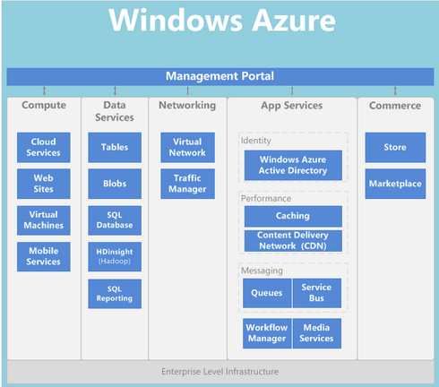
Microsoft Azure Data Center
Windows Azure is an Internet-scale computing and services platform hosted in data centers managed or supported by Microsoft.
Out business is a service; a service is capacity on demand.

Slide 12
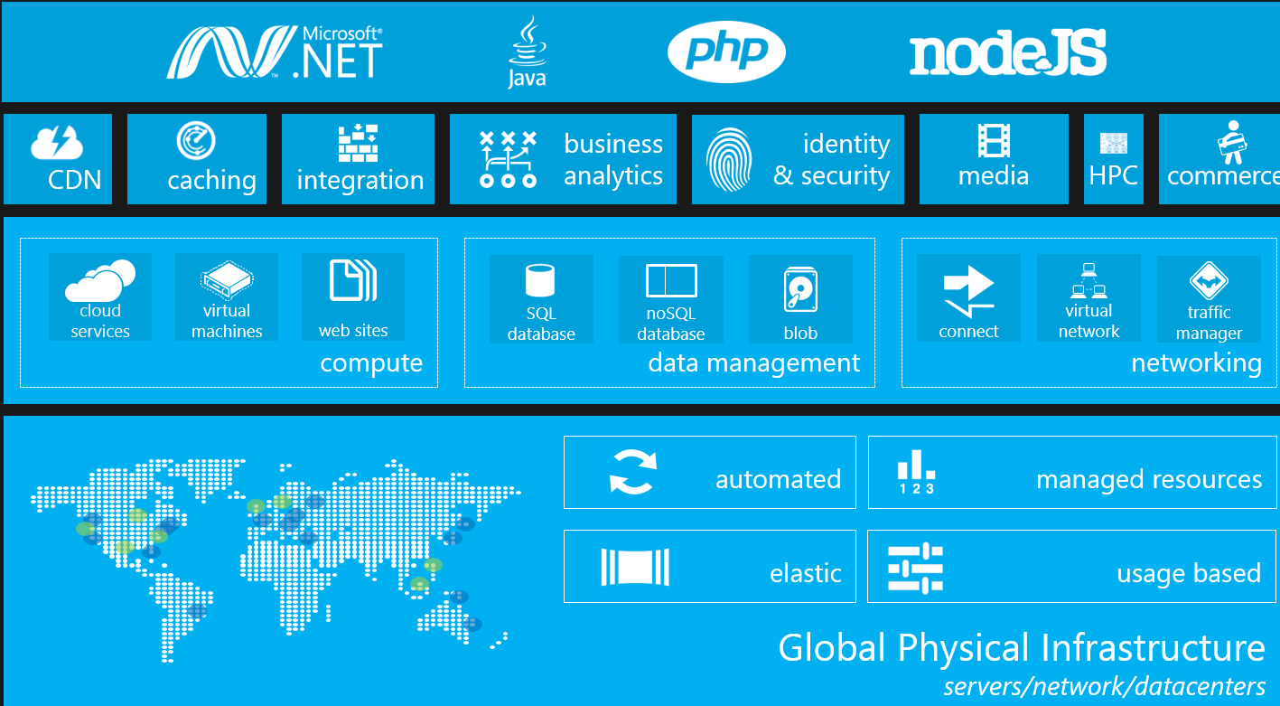
Windows Azure Platform Building Blocks

Slide 13
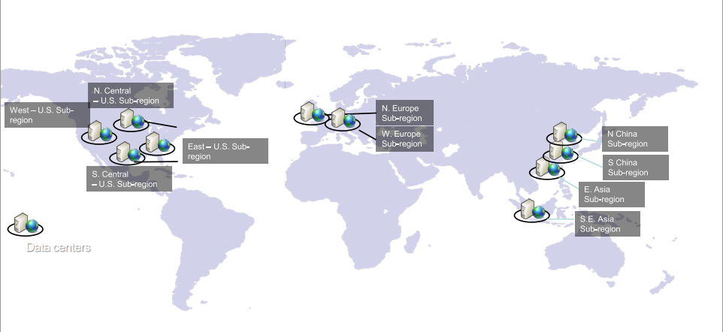
Azure Data Center Regions

Slide 14
Scalability
“Growing Fast“
Compute
Average Usage
Time
Successful services needs to grow/scale
Keeping up with growth is big IT challenge
Complex lead time for deployment
Worker Role
Web Role
Input Queue (Work Items)
Worker Role
Web Role
Queue
Worker Role
Web Role
Worker Role

Slide 15
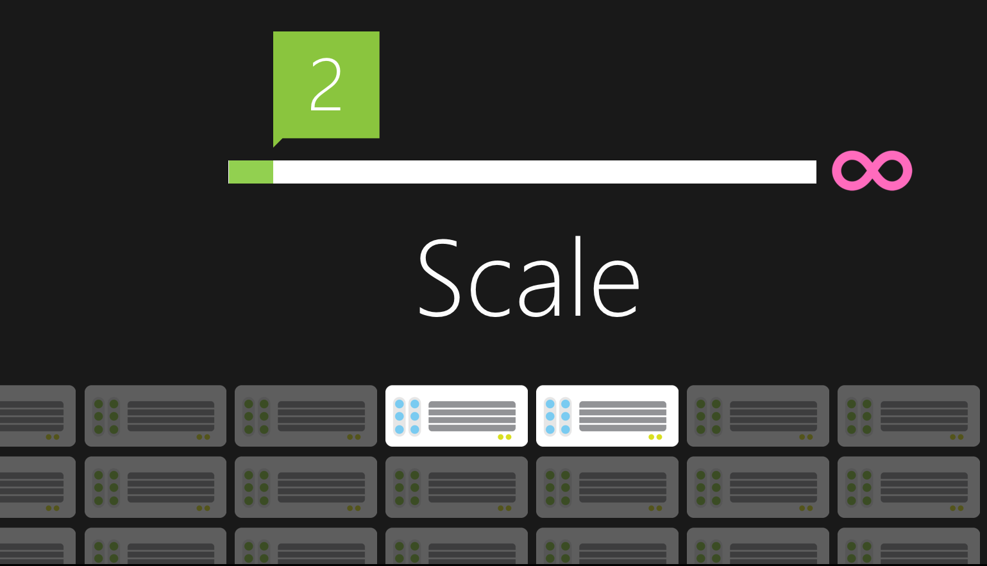
Scalability

Slide 16
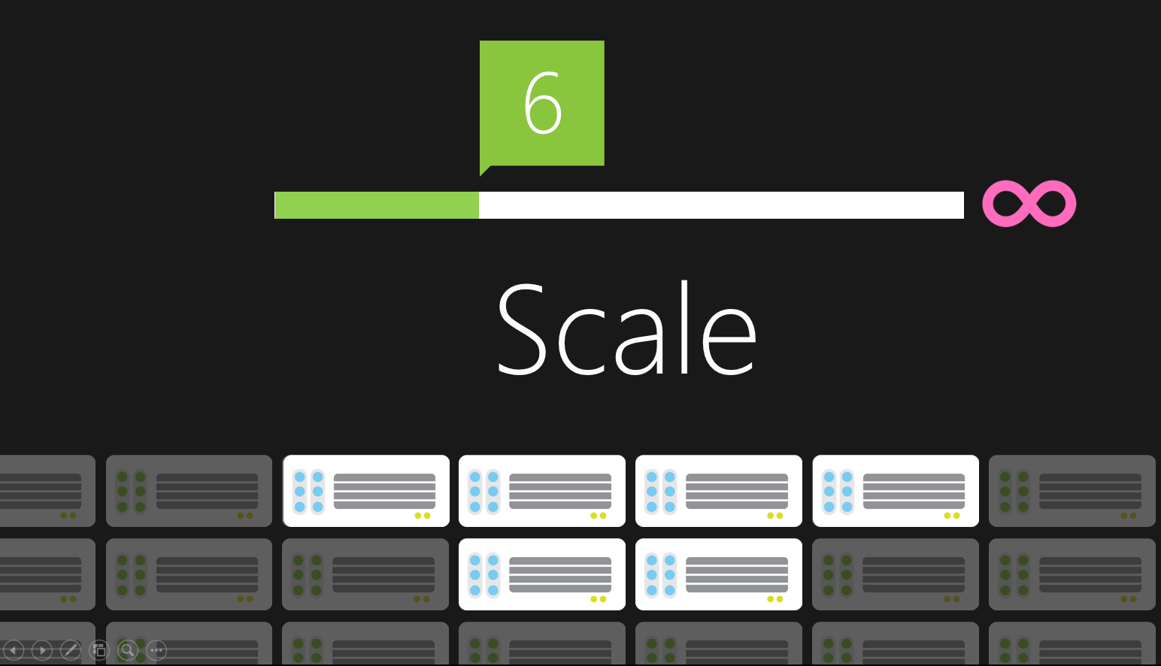
Scalability

Slide 17
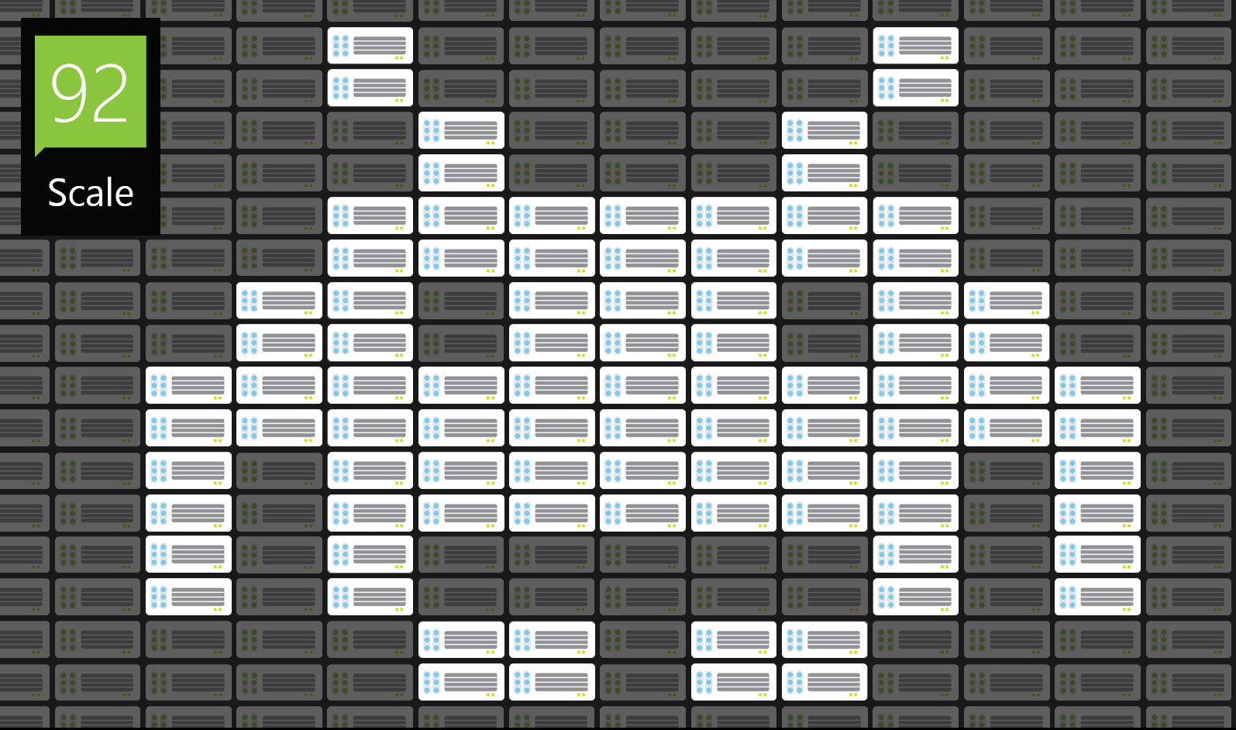
Scalability

Slide 18
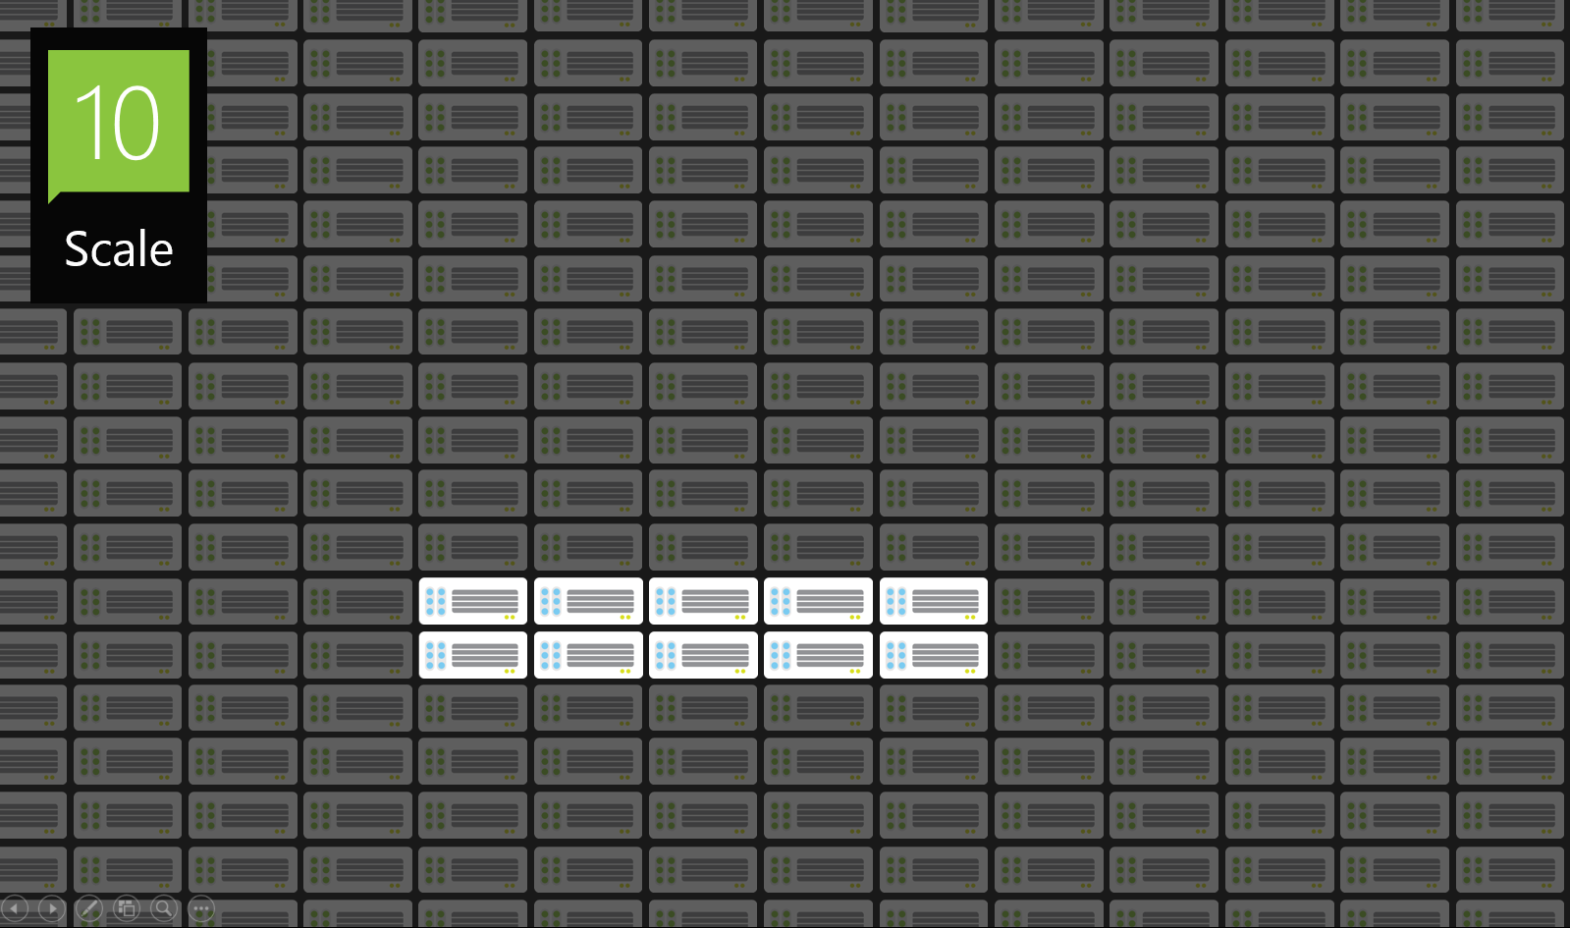
Scalability

Slide 19
Usage Based
Pay only for what PAC uses

Slide 20
Service Level Agreement
99.95% monthly SLA

Slide 21
Agile Software Development Process

Slide 22
High Level Technology Overview and Products

Slide 23
High Level Business Process Flow

Slide 24
Roadmap
Short term objectives (45 days)
Hire IT Core Team
Document detail software features
Mid term objectives (46 days to 6 months)
Build external portals
Build internal line of business applications
Build customer profiles
Build PCRP algorithm prototype
Build Reporting capabilities
Long-term objectives (longer than 6 months)
Develop Standard Operating Procedures to be compliant.
Make site bi-lingual
Make mobile app
Build interfaces to collect data customer transactional data
Banks, purchases, payments, FICO scores, etc.

Slide 25
Q&A
Plan
Execute
Improve

